Slide 1
Dynamic programming: Even More fun!
David Kauchak CS 140 – Spring 2023

Slide 2
Admin
Assignment 5

Slide 3
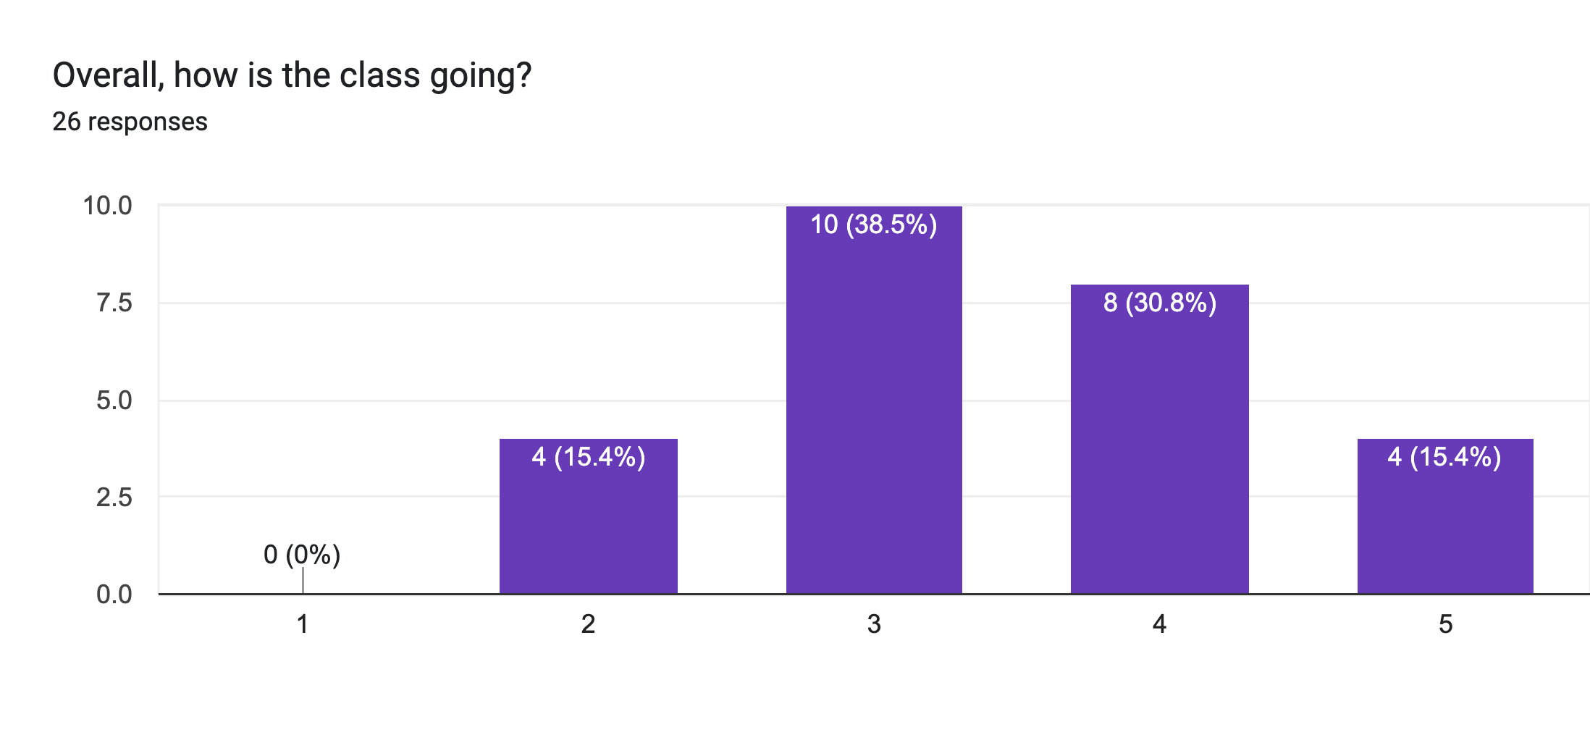
Overall how is the class going

Slide 4
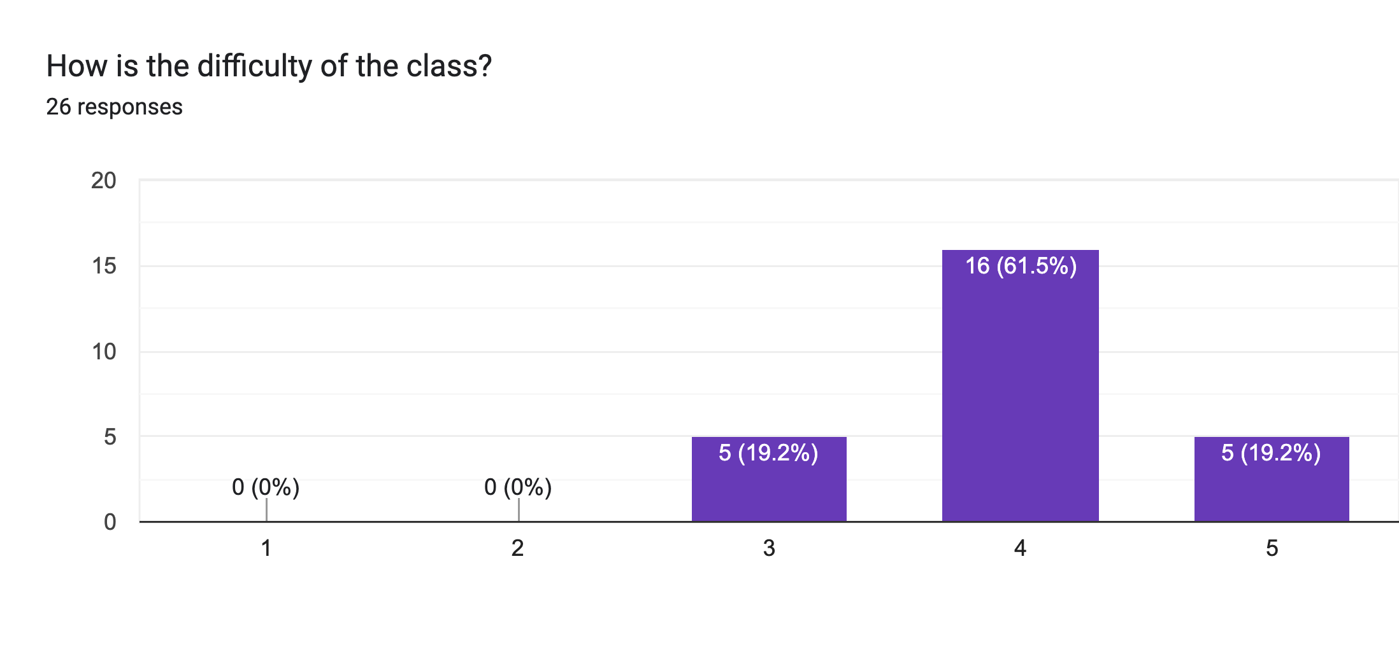
How difficult is the class

Slide 5
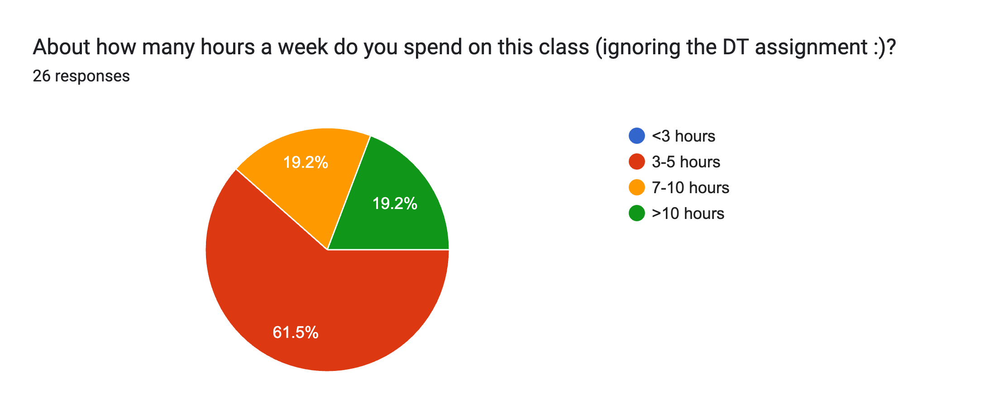
Time spent

Slide 6
What’s going well?
The short clips at the start
working with partners!
I finally get to learn DP!
the versatility of the PS because I feel like I'm practicing multiple different concepts
The topic is genuinely interesting and I love thinking of algorithms, they remind be of puzzles.

Slide 7
What could be improved?
sometimes the pace of the lectures feel a bit fast
no group sessions
late days
The content feels way too theoretical
Less proofs, less inductions pls
Possible Saturday mentor sessions

Slide 8
What could be improved?
It also feels like a level of background is expected from students, even though that background has not been built through previous Pomona CS classes so it feels very unfair to those of us who weren't exposed to CS beyond or before Pomona.

Slide 9
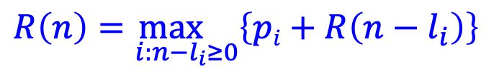
Rod splitting example
length: 1 3 5 6 8
price: 1 6 9 13 16
$$R\left(n\right)=\max_{i:n−l_{i}≥0}\left\{pi+R\left(n−l_{i}\right)\right\}$$
R 0 1 2 3 4 5 6 7 8 9 10 11 12

Slide 10
Rod splitting example
length: 1 3 5 6 8
price: 1 6 9 13 16
0 1 2
R 0 1 2 3 4 5 6 7 8 9 10 11 12
Choice: 1 1

Slide 11
Rod splitting example
length: 1 3 5 6 8
price: 1 6 9 13 16
3: 6 + R[0] = 6
1: 1 + R[2] = 3
0 1 2 6
R 0 1 2 3 4 5 6 7 8 9 10 11 12
Choice: 1 1 3

Slide 12
Rod splitting example
length: 1 3 5 6 8
price: 1 6 9 13 16
3: 6 + R[1] = 7
1: 1 + R[3] = 7
0 1 2 6 7
R 0 1 2 3 4 5 6 7 8 9 10 11 12
Choice: 1 1 3 3

Slide 13
Rod splitting example
length: 1 3 5 6 8
price: 1 6 9 13 16
5: 9 + R[0] = 9
3: 6 + R[2] = 8
1: 1 + R[4] = 8
0 1 2 6 7 9
R 0 1 2 3 4 5 6 7 8 9 10 11 12
Choice: 1 1 3 3 5

Slide 14
Rod splitting example
length: 1 3 5 6 8
price: 1 6 9 13 16
6: 13 + R[0] = 13
5: 9 + R[1] = 10
3: 6 + R[3] = 12
1: 1 + R[5] = 10
0 1 2 6 7 9 13
R 0 1 2 3 4 5 6 7 8 9 10 11 12
Choice: 1 1 3 3 5 6

Slide 15
Rod splitting example
length: 1 3 5 6 8
price: 1 6 9 13 16
6: 13 + R[1] = 14
5: 9 + R[2] = 11
3: 6 + R[4] = 13
1: 1 + R[6] = 14
0 1 2 6 7 9 13 14
R 0 1 2 3 4 5 6 7 8 9 10 11 12
Choice: 1 1 3 3 5 6 6

Slide 16
Rod splitting example
length: 1 3 5 6 8
price: 1 6 9 13 16
8: 16 + R[0] = 16
6: 13 + R[2] = 15
5: 9 + R[3] = 15
3: 6 + R[5] = 15
1: 1 + R[7] = 15
0 1 2 6 7 9 13 14 16
R 0 1 2 3 4 5 6 7 8 9 10 11 12
Choice: 1 1 3 3 5 6 6 8

Slide 17
Rod splitting example
length: 1 3 5 6 8
price: 1 6 9 13 16
8: 16 + R[1] = 17
6: 13 + R[3] = 19
5: 9 + R[4] = 16
3: 6 + R[6] = 19
1: 1 + R[8] = 17
0 1 2 6 7 9 13 14 16 19
R 0 1 2 3 4 5 6 7 8 9 10 11 12
Choice: 1 1 3 3 5 6 6 8 6

Slide 18
Rod splitting example
length: 1 3 5 6 8
price: 1 6 9 13 16
8: 16 + R[2] = 18
6: 13 + R[4] = 20
5: 9 + R[5] = 18
3: 6 + R[7] = 20
1: 1 + R[9] = 20
0 1 2 6 7 9 13 14 16 19 20
R 0 1 2 3 4 5 6 7 8 9 10 11 12
Choice: 1 1 3 3 5 6 6 8 6 6

Slide 19
Rod splitting example
length: 1 3 5 6 8
price: 1 6 9 13 16
8: 16 + R[3] = 22
6: 13 + R[5] = 22
5: 9 + R[6] = 22
3: 6 + R[8] = 22
1: 1 + R[10] = 21
0 1 2 6 7 9 13 14 16 19 20 22
R 0 1 2 3 4 5 6 7 8 9 10 11 12
Choice: 1 1 3 3 5 6 6 8 6 6 8

Slide 20
Rod splitting example
length: 1 3 5 6 8
price: 1 6 9 13 16
8: 16 + R[4] = 23
6: 13 + R[6] = 26
5: 9 + R[7] = 23
3: 6 + R[9] = 25
1: 1 + R[11] = 23
0 1 2 6 7 9 13 14 16 19 20 22 26
R 0 1 2 3 4 5 6 7 8 9 10 11 12
Choice: 1 1 3 3 5 6 6 8 6 6 8 6

Slide 21
Rod splitting example
length: 1 3 5 6 8
price: 1 6 9 13 16
What cuts do we make?
0 1 2 6 7 9 13 14 16 19 20 22 26
R 0 1 2 3 4 5 6 7 8 9 10 11 12
Choice: 1 1 3 3 5 6 6 8 6 6 8 6

Slide 22
Rod splitting example
length: 1 3 5 6 8
price: 1 6 9 13 16
What cuts do we make?
0 1 2 6 7 9 13 14 16 19 20 22 26
R 0 1 2 3 4 5 6 7 8 9 10 11 12
Choice: 1 1 3 3 5 6 6 8 6 6 8 6
6 + R[6]

Slide 23
Rod splitting example
length: 1 3 5 6 8
price: 1 6 9 13 16
What cuts do we make?
0 1 2 6 7 9 13 14 16 19 20 22 26
R 0 1 2 3 4 5 6 7 8 9 10 11 12
Choice: 1 1 3 3 5 6 6 8 6 6 8 6
6 + R[0]
6 +

Slide 24
Rod splitting example
length: 1 3 5 6 8
price: 1 6 9 13 16
What cuts do we make?
0 1 2 6 7 9 13 14 16 19 20 22 26
R 0 1 2 3 4 5 6 7 8 9 10 11 12
Choice: 1 1 3 3 5 6 6 8 6 6 8 6

Slide 25
Rod splitting example
length: 1 3 5 6 8
price: 1 6 9 13 16
What cuts do we make?
0 1 2 6 7 9 13 14 16 19 20 22 26
R 0 1 2 3 4 5 6 7 8 9 10 11 12
Choice: 1 1 3 3 5 6 6 8 6 6 8 6
8 + R[3]

Slide 26
Rod splitting example
length: 1 3 5 6 8
price: 1 6 9 13 16
What cuts do we make?
0 1 2 6 7 9 13 14 16 19 20 22 26
R 0 1 2 3 4 5 6 7 8 9 10 11 12
Choice: 1 1 3 3 5 6 6 8 6 6 8 6
3 + R[0]
8 +

Slide 27
Rod splitting example
length: 1 3 5 6 8
price: 1 6 9 13 16
What cuts do we make?
0 1 2 6 7 9 13 14 16 19 20 22 26
R 0 1 2 3 4 5 6 7 8 9 10 11 12
Choice: 1 1 3 3 5 6 6 8 6 6 8 6

Slide 28
Rod splitting example
length: 1 3 5 6 8
price: 1 6 9 13 16
What cuts do we make?
0 1 2 6 7 9 13 14 16 19 20 22 26
R 0 1 2 3 4 5 6 7 8 9 10 11 12
Choice: 1 1 3 3 5 6 6 8 6 6 8 6
6 + R[4]

Slide 29
Rod splitting example
length: 1 3 5 6 8
price: 1 6 9 13 16
What cuts do we make?
0 1 2 6 7 9 13 14 16 19 20 22 26
R 0 1 2 3 4 5 6 7 8 9 10 11 12
Choice: 1 1 3 3 5 6 6 8 6 6 8 6
3 + R[1]
6 +

Slide 30
Rod splitting example
length: 1 3 5 6 8
price: 1 6 9 13 16
What cuts do we make?
0 1 2 6 7 9 13 14 16 19 20 22 26
R 0 1 2 3 4 5 6 7 8 9 10 11 12
Choice: 1 1 3 3 5 6 6 8 6 6 8 6
1 + R[0]
3 +
6 +

Slide 31
Longest increasing subsequence
Given a sequence of numbers X = x₁, x₂, …, x_{n} find the longest increasing subsequence
(i₁, i₂, …, i_{m}), i.e., a subsequence where numbers in the sequence increase.
5 2 8 6 3 6 9 7

Slide 32
Longest increasing subsequence
Given a sequence of numbers X = x₁, x₂, …, x_{n} find the longest increasing subsequence
(i₁, i₂, …, i_{m}), i.e., a subsequence where numbers in the sequence increase.
5 2 8 6 3 6 9 7

Slide 33
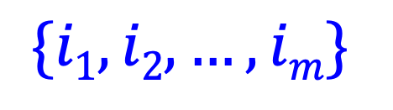
1a: optimal substructure
Prove: optimal solutions to the problem incorporate optimal solutions to related subproblems
5 2 8 6 3 6 9 7
$$\{i1, i2, …, im\}$$
What would a solution to a subproblem look like?

Slide 34
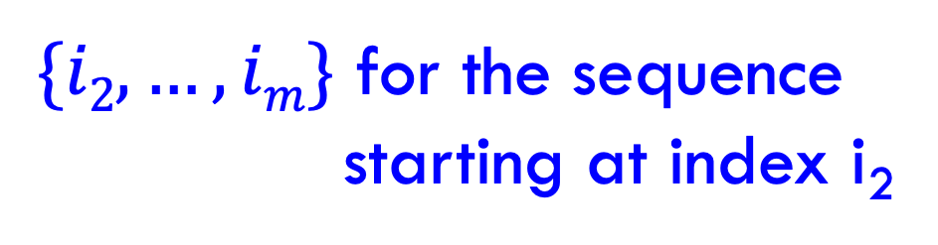
1a: optimal substructure
Prove: optimal solutions to the problem incorporate optimal solutions to related subproblems
5 2 8 6 3 6 9 7
$$\{i1, i2, …, im\}$$
$\{i2, …, im\}$ for the sequence
starting at index i₂

Slide 35
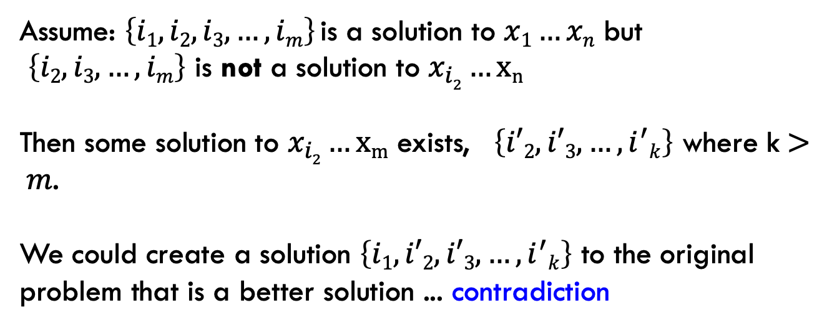
1a: optimal substructure
Prove: optimal solutions to the problem incorporate optimal solutions to related subproblems
Proof by contradiction:
Assume: $\left\{i1, i2, i3, …, im\right\}$is a solution to $x1…xn$ but
$\left\{i2, i3, …, im\right\}$ is not a solution to $x_{i2}…xn$
Then some solution to $x_{i2}…xm$ exists, $\left\{i′2, i′3, …, i^{′}k\right\}$ where k$> m$.
We could create a solution $\left\{i1,i′2, i′3, …, i^{′}k\right\}$ to the original problem that is a better solution ... contradiction

Slide 36
1b: recursive solution
5 2 8 6 3 6 9 7
Is 5 part off the LIS?

Slide 37
1b: recursive solution
5 2 8 6 3 6 9 7
Two options: Either 5 is in the LIS or it’s not

Slide 38
1b: recursive solution
5 2 8 6 3 6 9 7
include 5
5 + LIS(8 6 3 6 9 7)

Slide 39
1b: recursive solution
5 2 8 6 3 6 9 7
include 5
5 + LIS(8 6 3 6 9 7)
What is this function exactly?
longest increasing sequence of the numbers
longest increasing sequence of the numbers starting with 8

Slide 40
1b: recursive solution
5 2 8 6 3 6 9 7
include 5
5 + LIS(8 6 3 6 9 7)
What is this function exactly?
longest increasing sequence of the numbers
This would allow for the option of sequences starting with 3 which are NOT valid!

Slide 41
1b: recursive solution
5 2 8 6 3 6 9 7
include 5
5 + LIS’(8 6 3 6 9 7)
longest increasing sequence of the numbers starting with 8
Do we need to consider anything else for subsequences starting at 5?

Slide 42
1b: recursive solution
5 2 8 6 3 6 9 7
include 5
5 + LIS’(8 6 3 6 9 7)
5 + LIS’(6 3 6 9 7)
5 + LIS’(6 9 7)
5 + LIS’(9 7)
5 + LIS’(7)

Slide 43
1b: recursive solution
5 2 8 6 3 6 9 7
don’t include 5
LIS(2 8 6 3 6 9 7)
Anything else?
Technically, this is fine, but now we have LIS and LIS’ to worry about.
Can we rewrite LIS in terms of LIS’?

Slide 44
1b: recursive solution
Longest increasing sequence for X is the longest increasing sequence starting at any element
And what is LIS’ defined as (recursively)?

Slide 45
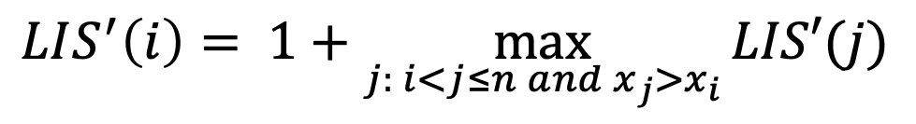
1b: recursive solution
Longest increasing sequence for X is the longest increasing sequence starting at any element
$$LIS^{′}\left(i\right)= 1+\max_{j: i<j≤n and x_{j}>x_{i}}{LIS′(j)}$$
Longest increasing sequence starting at i

Slide 46
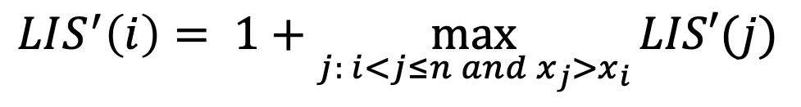
2: DP solution (bottom-up)
$$LIS^{′}\left(i\right)= 1+\max_{j: i<j≤n and x_{j}>x_{i}}{LIS′(j)}$$
LIS’:
5 2 8 6 3 6 9 7

Slide 47
2: DP solution (bottom-up)
$$LIS^{′}\left(i\right)= 1+\max_{j: i<j≤n and x_{j}>x_{i}}{LIS′(j)}$$
LIS’: 1
5 2 8 6 3 6 9 7

Slide 48
2: DP solution (bottom-up)
$$LIS^{′}\left(i\right)= 1+\max_{j: i<j≤n and x_{j}>x_{i}}{LIS′(j)}$$
LIS’: 1
5 2 8 6 3 6 9 7

Slide 49
2: DP solution (bottom-up)
$$LIS^{′}\left(i\right)= 1+\max_{j: i<j≤n and x_{j}>x_{i}}{LIS′(j)}$$
LIS’: 1 1
5 2 8 6 3 6 9 7

Slide 50
2: DP solution (bottom-up)
$$LIS^{′}\left(i\right)= 1+\max_{j: i<j≤n and x_{j}>x_{i}}{LIS′(j)}$$
LIS’: 1 1
5 2 8 6 3 6 9 7

Slide 51
2: DP solution (bottom-up)
$$LIS^{′}\left(i\right)= 1+\max_{j: i<j≤n and x_{j}>x_{i}}{LIS′(j)}$$
LIS’: 2 1 1
5 2 8 6 3 6 9 7

Slide 52
2: DP solution (bottom-up)
$$LIS^{′}\left(i\right)= 1+\max_{j: i<j≤n and x_{j}>x_{i}}{LIS′(j)}$$
LIS’: 3 2 1 1
5 2 8 6 3 6 9 7

Slide 53
2: DP solution (bottom-up)
$$LIS^{′}\left(i\right)= 1+\max_{j: i<j≤n and x_{j}>x_{i}}{LIS′(j)}$$
LIS’: 2 3 2 1 1
5 2 8 6 3 6 9 7

Slide 54
2: DP solution (bottom-up)
$$LIS^{′}\left(i\right)= 1+\max_{j: i<j≤n and x_{j}>x_{i}}{LIS′(j)}$$
LIS’: 2 2 3 2 1 1
5 2 8 6 3 6 9 7

Slide 55
2: DP solution (bottom-up)
$$LIS^{′}\left(i\right)= 1+\max_{j: i<j≤n and x_{j}>x_{i}}{LIS′(j)}$$
LIS’: 4 2 2 3 2 1 1
5 2 8 6 3 6 9 7

Slide 56
2: DP solution (bottom-up)
$$LIS^{′}\left(i\right)= 1+\max_{j: i<j≤n and x_{j}>x_{i}}{LIS′(j)}$$
LIS’: 3 4 2 2 3 2 1 1
5 2 8 6 3 6 9 7

Slide 57
2: DP solution (bottom-up)
$$LIS^{′}\left(i\right)= 1+\max_{j: i<j≤n and x_{j}>x_{i}}{LIS′(j)}$$
LIS’: 3 4 2 2 3 2 1 1
5 2 8 6 3 6 9 7

Slide 58
2: DP solution (bottom-up)
$$LIS^{′}\left(i\right)= 1+\max_{j: i<j≤n and x_{j}>x_{i}}{LIS′(j)}$$
What does the table for storing answers look like?

Slide 59
2: DP solution (bottom-up)
$$LIS^{′}\left(i\right)= 1+\max_{j: i<j≤n and x_{j}>x_{i}}{LIS′(j)}$$
1-D array: only one thing changes for recursive calls

Slide 60
2: DP solution (bottom-up)
$$LIS^{′}\left(i\right)= 1+\max_{j: i<j≤n and x_{j}>x_{i}}{LIS′(j)}$$
What are the “smallest” possible subproblems?
To calculate LIS’(n), what are all the subproblems we need to calculate? This is the “table”.
How should we fill in the table?
Where will the answer be?

Slide 61
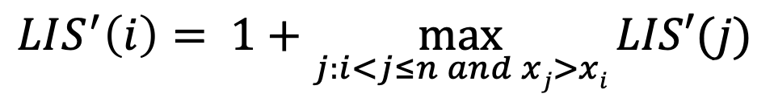
2: DP solution (bottom-up)
$$LIS^{′}\left(i\right)= 1+\max_{j:i<j≤n and xj>xi}{LIS′(j)}$$
What are the “smallest” possible subproblems?
LIS’(n) and that is well-defined for this problem
To calculate LIS’(i), what are all the subproblems we need to calculate? This is the “table”.
LIS’(1) … LIS’(n)
How should we fill in the table?
n → 1
Where will the answer be?
max(LIS’(1)…LIS’(n))

Slide 62
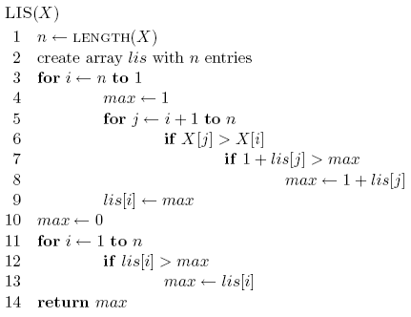
2: DP solution (bottom-up)

Slide 63
2: DP solution (bottom-up)
start from the end (bottom)

Slide 64

2: DP solution (bottom-up)
$$LIS^{′}\left(i\right)= 1+\max_{j:i<j≤n and xj>xi}{LIS′(j)}$$

Slide 65
2: DP solution (bottom-up)

Slide 66

3: Analysis
Space requirements?
Running time?

Slide 67
3: Analysis
Space requirements: Θ(n)
Running time: Θ(n²)

Slide 68
Another solution
Can we use LCS to solve this problem?
5 2 8 6 3 6 9 7
LCS
2 3 5 6 6 7 8 9

Slide 69
Another solution
Can we use LCS to solve this problem?
5 2 8 6 3 6 9 7
LCS
2 3 5 6 6 7 8 9

Slide 70
Edit distance (aka Levenshtein distance)
Edit distance between two strings is the minimum number of insertions, deletions and substitutions required to transform string s₁ into string s₂
Insertion:
ABACED
ABACCED
DABACCED
Insert ‘C’
Insert ‘D’

Slide 71
Edit distance (aka Levenshtein distance)
Edit distance between two strings is the minimum number of insertions, deletions and substitutions required to transform string s₁ into string s₂
Deletion:
ABACED

Slide 72
Edit distance (aka Levenshtein distance)
Edit distance between two strings is the minimum number of insertions, deletions and substitutions required to transform string s₁ into string s₂
Deletion:
ABACED
BACED
Delete ‘A’

Slide 73
Edit distance (aka Levenshtein distance)
Edit distance between two strings is the minimum number of insertions, deletions and substitutions required to transform string s₁ into string s₂
Deletion:
ABACED
BACED
BACE
Delete ‘A’
Delete ‘D’

Slide 74
Edit distance (aka Levenshtein distance)
Edit distance between two strings is the minimum number of insertions, deletions and substitutions required to transform string s₁ into string s₂
Substitution:
ABACED
ABADED
ABADES
Sub ‘D’ for ‘C’
Sub ‘S’ for ‘D’

Slide 75
Edit distance examples
Edit(Kitten, Mitten) =
1
Operations:
Sub ‘M’ for ‘K’
Mitten

Slide 76
Edit distance examples
Edit(Happy, Hilly) =
3
Operations:
Sub ‘a’ for ‘i’
Hippy
Sub ‘l’ for ‘p’
Hilpy
Sub ‘l’ for ‘p’
Hilly

Slide 77
Edit distance examples
Edit(Banana, Car) =
5
Operations:
Delete ‘B’
anana
Delete ‘a’
nana
Delete ‘n’
naa
Sub ‘C’ for ‘n’
Caa
Sub ‘a’ for ‘r’
Car

Slide 78
Edit distance examples
Edit(Simple, Apple) =
3
Operations:
Delete ‘S’
imple
Sub ‘A’ for ‘i’
Ample
Sub ‘m’ for ‘p’
Apple

Slide 79
Edit distance
Why might this be useful?

Slide 80
Is edit distance symmetric?
that is, is Edit(s₁, s₂) = Edit(s₂, s₁)?
Why?
sub ‘i’ for ‘j’ → sub ‘j’ for ‘i’
delete ‘i’ → insert ‘i’
insert ‘i’ → delete ‘i’
Edit(Simple, Apple) =? Edit(Apple, Simple)

Slide 81
Calculating edit distance
X = A B C B D A B
Y = B D C A B A
Ideas? How can we break this into subproblems?

Slide 82
Calculating edit distance
X = A B C B D A ?
Y = B D C A B ?
After all of the operations, X needs to equal Y
Start with the last two characters

Slide 83
Calculating edit distance
X = A B C B D A ?
Y = B D C A B ?
Operations:
Insert
Delete
Substitute
Assume they’re different
How can we make them the same?

Slide 84
Insert
X = A B C B D A ?
Y = B D C A B ?
How can we use insert to transform X into Y?

Slide 85
Insert
X = A B C B D A ? ?
Y = B D C A B ?
insert the last character of Y to the end of X

Slide 86
Insert
X = A B C B D A ? ?
Y = B D C A B ?
How does this make the problem smaller?

Slide 87
Insert
X = A B C B D A ? ?
Edit
Y = B D C A B ?

Slide 88
Delete
X = A B C B D A ?
Y = B D C A B ?
How can we use delete to transform X into Y?

Slide 89
Delete
X = A B C B D A
Edit
Y = B D C A B ?

Slide 90
Substition
X = A B C B D A ?
Y = B D C A B ?
How can we use substitution to transform X into Y?

Slide 91
Substition
X = A B C B D A ?
Edit
Y = B D C A B ?

Slide 92
Anything else?
X = A B C B D A ?
Y = B D C A B ?

Slide 93
Equal
X = A B C B D A ?
Y = B D C A B ?
What if the last characters are equal?

Slide 94
Equal
X = A B C B D A ?
Edit
Y = B D C A B ?

Slide 95


1b: recursive solution - combining results
Insert:
Delete:
$$Xn≠Ym$$
Substitute:
$$Xn=Ym$$
Equal:
How do we decide between these?

Slide 96
1b: recursive solution - combining results
1: if they’re different
0: if they’re the same

Slide 97
2: DP solution (bottom-up)
What does the table for storing answers look like?

Slide 98
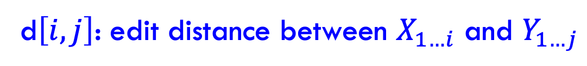

2: DP solution (bottom-up)
$$Edit(X_{1…i},Y_{1…j})$$
d$\left[i,j\right]$: edit distance between $X_{1…i}$ and $Y_{1…j}$

Slide 99
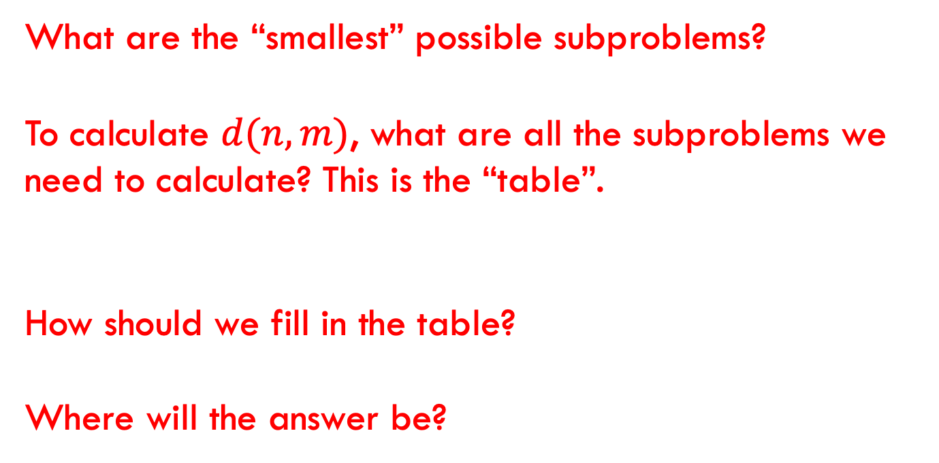
2: DP solution (bottom-up)
What are the “smallest” possible subproblems?
To calculate $d(n,m)$, what are all the subproblems we need to calculate? This is the “table”.
How should we fill in the table?
Where will the answer be?

Slide 100
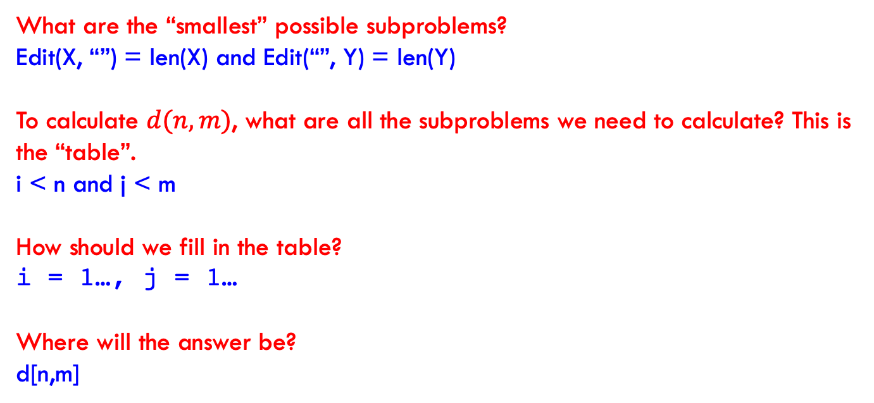
2: DP solution (bottom-up)
What are the “smallest” possible subproblems?
Edit(X, “”) = len(X) and Edit(“”, Y) = len(Y)
To calculate $d(n,m)$, what are all the subproblems we need to calculate? This is the “table”.
i < n and j < m
How should we fill in the table?
i = 1…, j = 1…
Where will the answer be?
d[n,m]

Slide 101
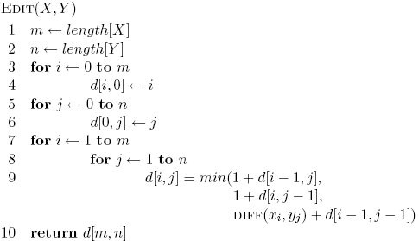
2: DP solution (bottom-up)

Slide 102
3: analysis
Space requirements?
Running time?

Slide 103
3: analysis
Space requirements: Θ(nm)
Running time: Θ(nm)

Slide 104
Edit distance variants
Only include insertions and deletions
What does this do to substitutions?
Include swaps, i.e. swapping two adjacent characters counts as one edit
Weight insertion, deletion and substitution differently
Weight specific character insertion, deletion and substitutions differently
Length normalize the edit distance

Slide 105
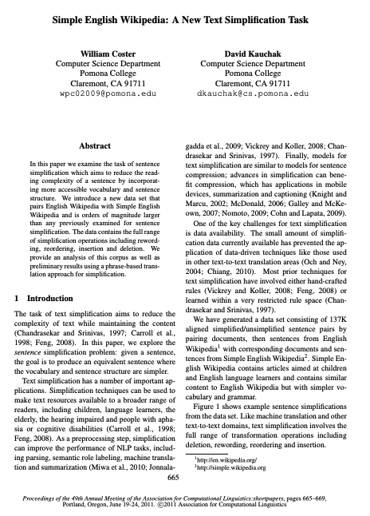
DP in practice

Slide 106
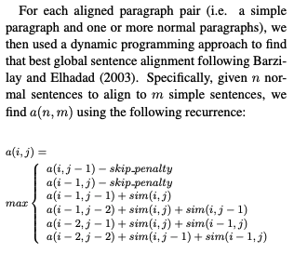

Slide 107
Skiers and Skis
Skis: 1 5 5 7 9 12 12 13
Skiers: 6 7 7 10 12
What is the optimal matching?

Slide 108
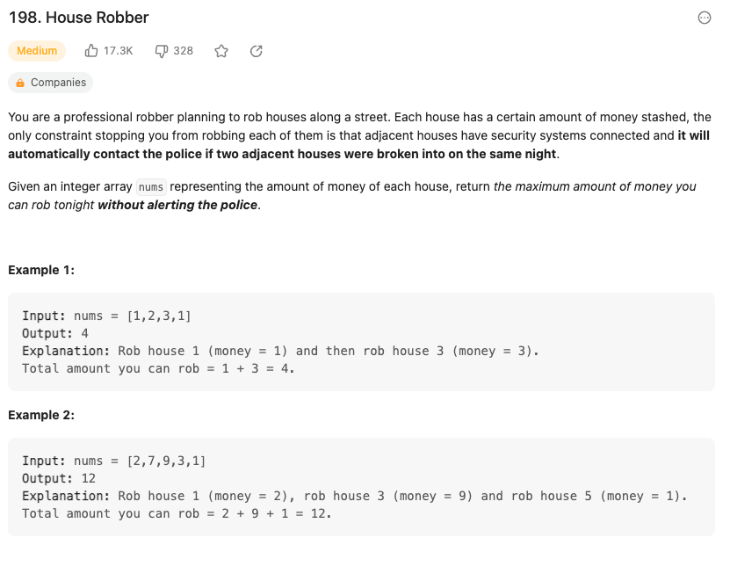
https://leetcode.com/problems/house-robber/

Slide 109
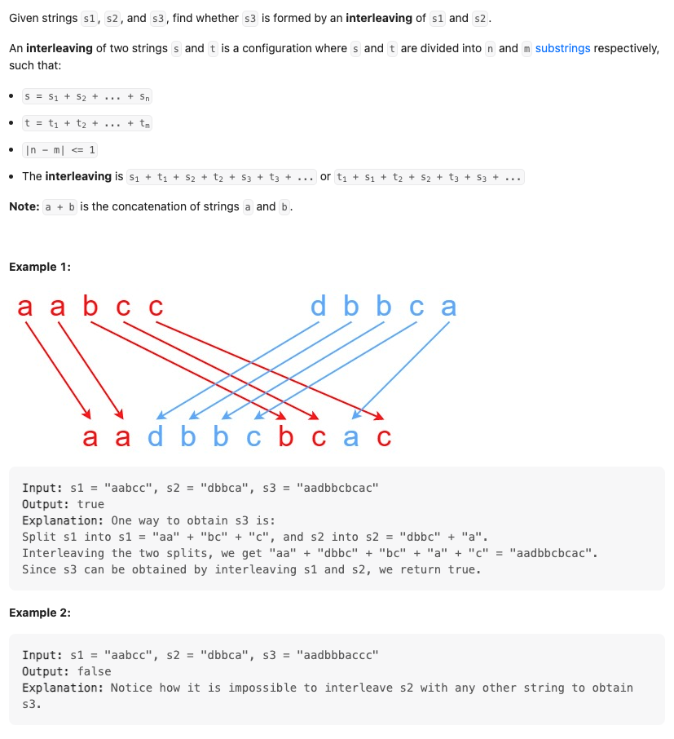
https://leetcode.com/problems/interleaving-string/description/

Slide 110
Memoization?

